Slide 1


Slide 2

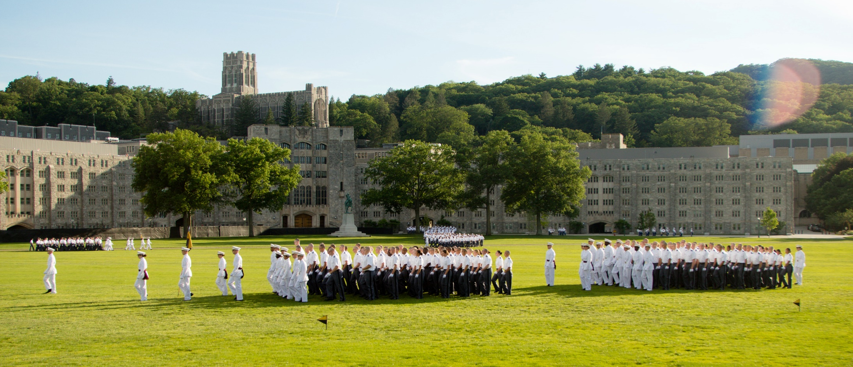

Slide 3

  14,000 applicants
  4,000 nominated
  2,500 meet requirements
  1,200 are enrolled
  1 in 5

Slide 4
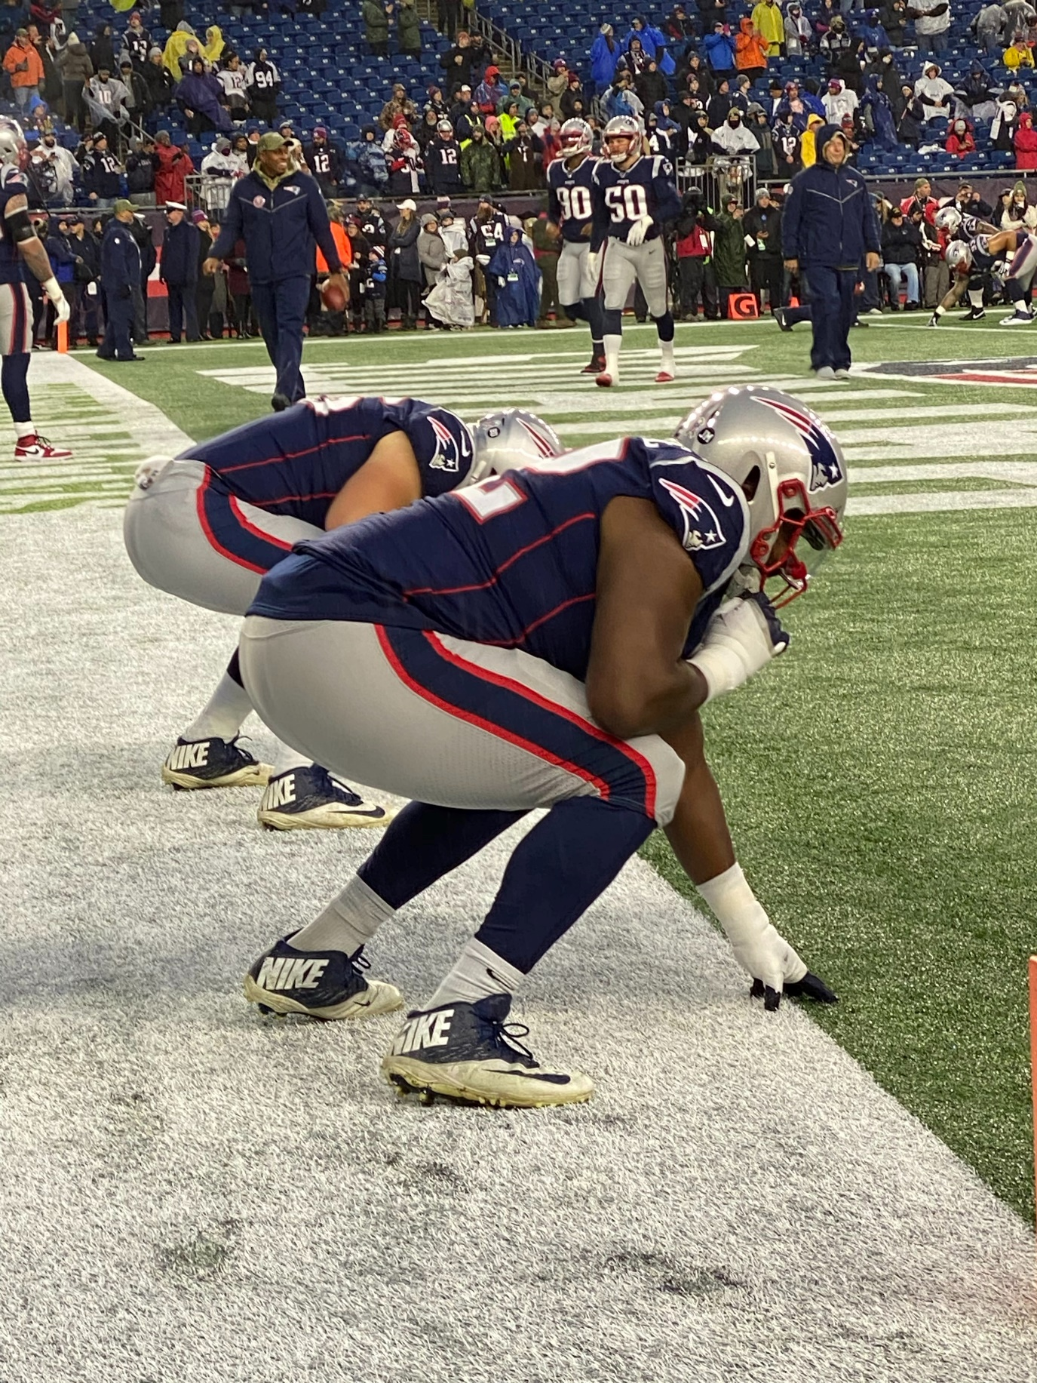
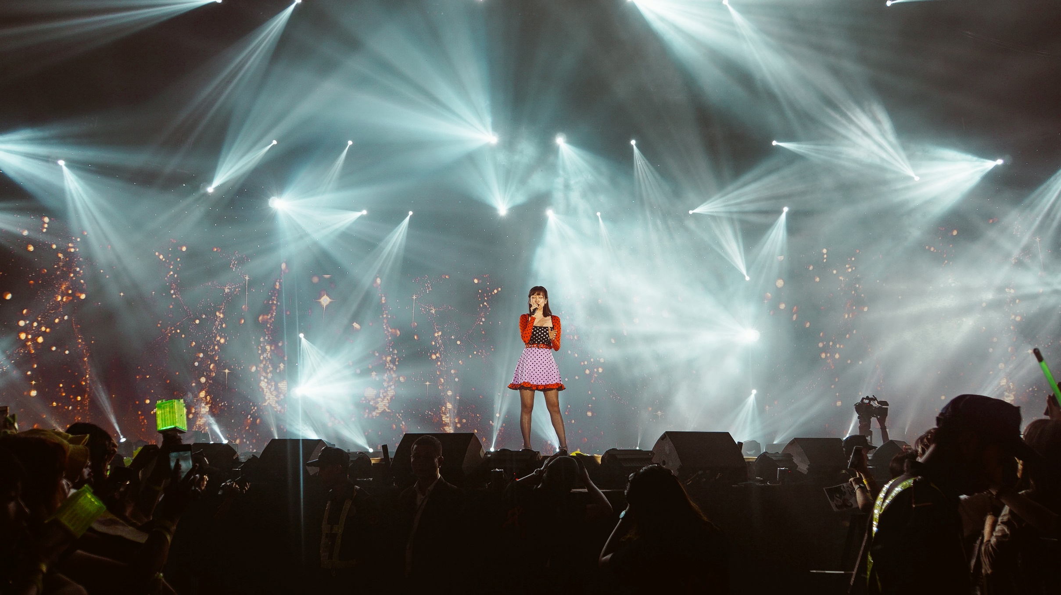
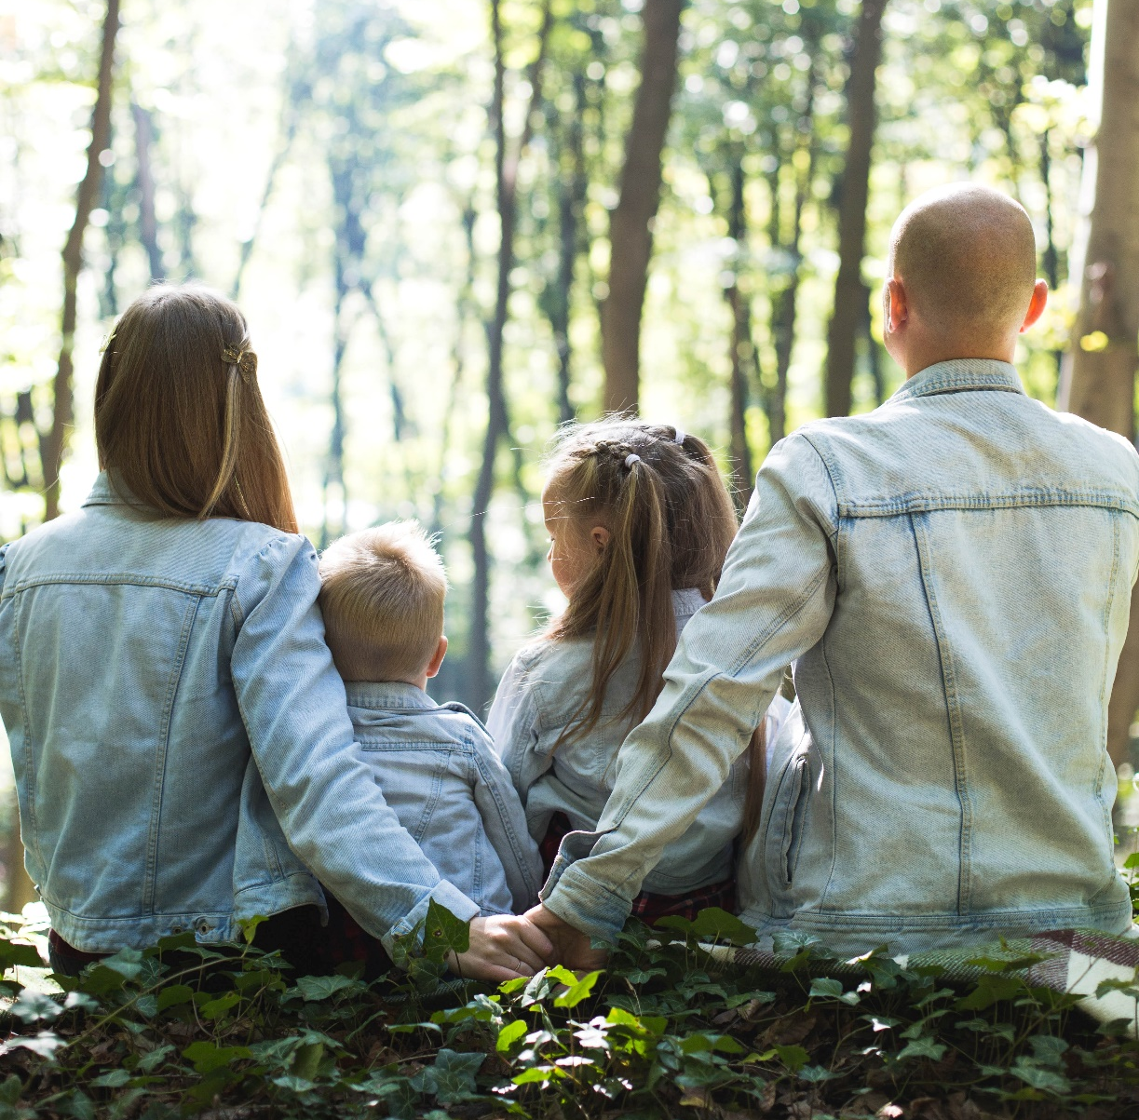



Slide 5
  “…Jesus began to tell his disciples plainly that it was necessary for him to go to Jerusalem, and that he would suffer many terrible things at the hands
  of the elders, the leading priests,

Slide 6
  and the teachers of religious law.
  He would be killed, but on the third day
  he would be raised from the dead”
  Matthew 16:21NLT

Slide 7
  Jesus turned to Peter and said, “Get away from me, Satan! You are a dangerous trap to me. You are seeing things merely from a human point of view, not from God’s.” Matthew 16:23 NLT

Slide 8
  When the stakes were high, and literally
  the fate of the world was in his hands,
  Jesus stayed true to his message.

Slide 9
  “Now I say to you that you are Peter
  (which means ‘rock’), and upon this rock I
  will build my church, and all the powers
  of hell will not conquer it.

Slide 10
  And I will give you the keys of the kingdom of Heaven.” Matthew 16:18-19 NLT

Slide 11
  “I tell you the truth Peter – this very night, before
  the rooster crows, you will deny three times that
  you even know me.” Matthew 26:34 NLT

Slide 12
  The world needs to know the hope
  and message of Jesus living in you.

Slide 13
