Slide 1


Slide 2

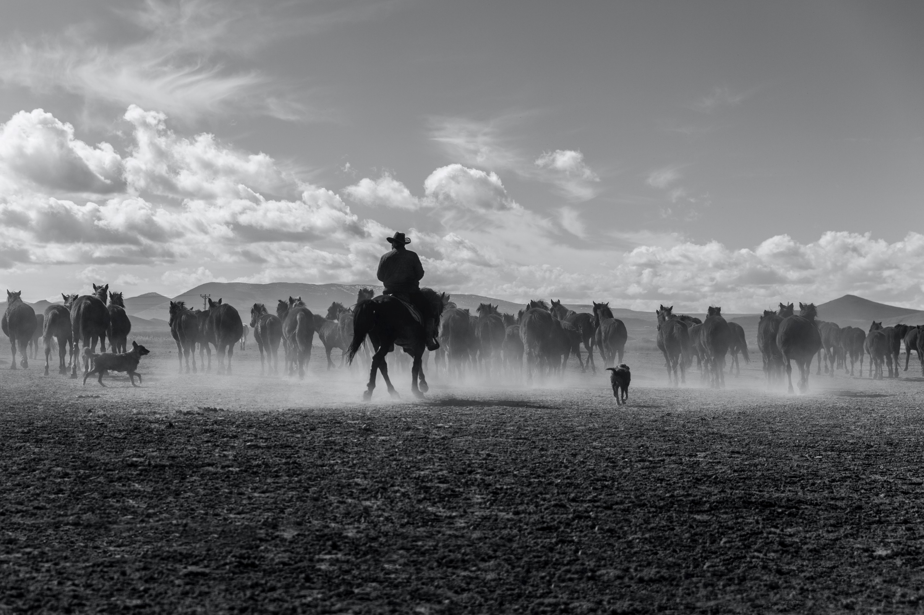

Slide 3
  “You will be with child and give birth
  to a son, and you are to give him
  the name Jesus.

Slide 4
  He will be great and will be called the
  Son of the Most High. The Lord God will
  give him the throne of his father David,

Slide 5
  and he will reign over the house of
  Jacob forever; his kingdom will never end.”
  Luke 1:31-33 NIV

Slide 6
  “She will give birth to a son, and you are
  to give him the name Jesus, because he
  will save his people from their sins.”
  Matthew 1:21 NIV

Slide 7
  “The next day he saw Jesus coming to him
  and said, ‘Behold, the Lamb of God who
  takes away the sin of the world!’”
  John 1:29 NASB

Slide 8
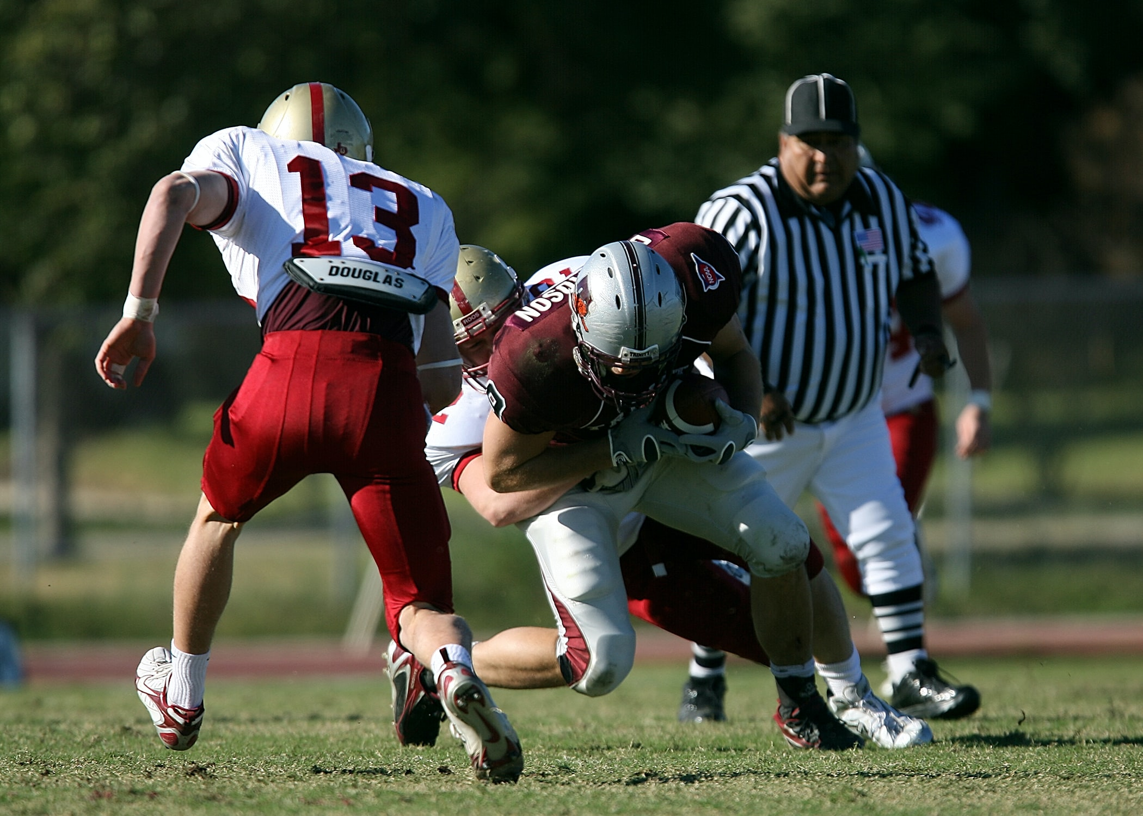

Slide 9
  Their rejection would not be His limitation!

Slide 10
  Jesus demonstrated grit over quit for His mission, so we can have the opportunity to live a life
  filled with grit over quit in our mission,
  even in the face of adversity!

Slide 11
  Followers dig in, lean in, and strive for clarity,
  all with a power that is not their own!

Slide 12
  Jesus isn’t looking for something from you,
  He is wanting something for you!

Slide 13
  I had grit and didn’t quit. I overcame!
  I promise, with me you will overcome too!

Slide 14
