Slide 1


Slide 2

  “In the beginning was the Word, and the Word was with God, and the Word was God.
  He was with God in the beginning.

Slide 3
  Through him all things were made;
  without him nothing was made that has
  been made. In him was life, and that life
  was the light of men.

Slide 4
  The light shines in the darkness, but
  the darkness has not understood it.”
  John 1:1-5 NIV

Slide 5
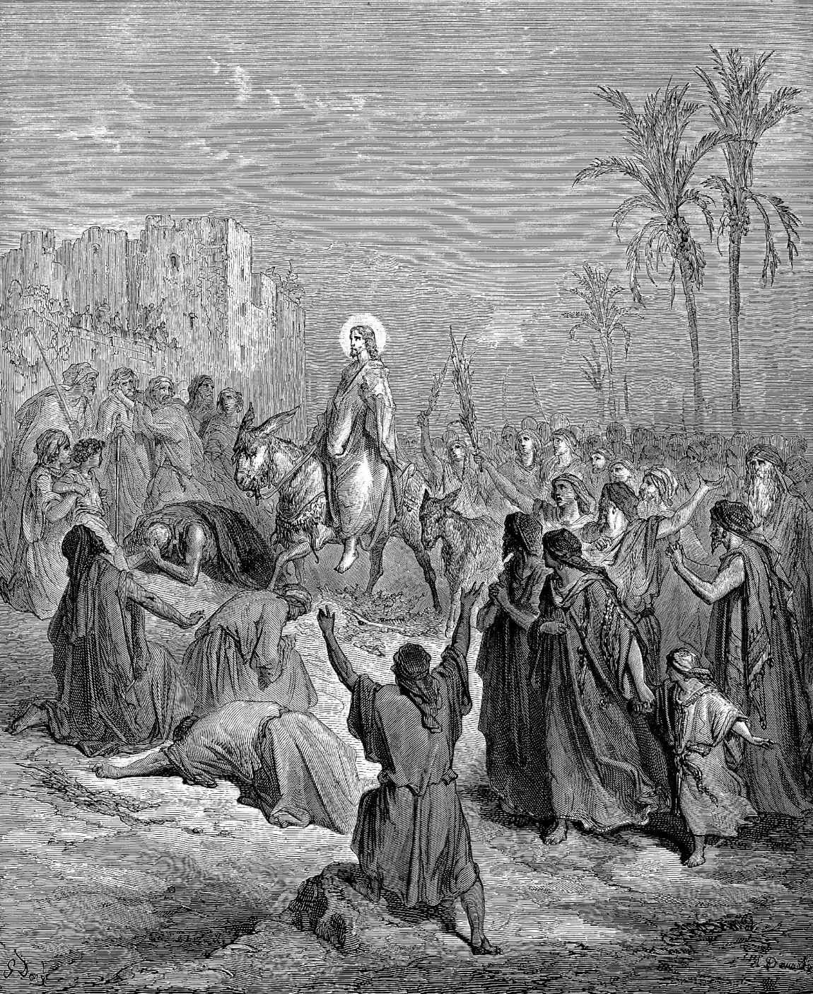

Slide 6
  Even though Jesus was misunderstood
  He didn’t quit!

Slide 7
  “Now there was a man of the Pharisees named Nicodemus, a member of
  the Jewish ruling council.

Slide 8
  He came to Jesus at night and said,
  “Rabbi, we know you are a teacher who has come from God. For no one could perform the miraculous signs you are doing if
  God were not with him.” John 3:1-2 NIV

Slide 9
  Jesus doesn’t want something from you
  He wants something for you!

Slide 10
  …Jesus declared, “I tell you the truth,
  no one can see the kingdom of God
  unless he is born again.” John 3:3 NIV

Slide 11
  Jesus is offering all of us the opportunity
  to move beyond our misunderstandings
  and experience His presence, where
  we will receive power that will transform
  us into a new person!

Slide 12
  “And if the Spirit of him who raised Jesus from the dead is living in you, he who
  raised Christ from the dead will also give
  life to your mortal bodies through his Spirit, who lives in you.” Romans 8:11 NIV

Slide 13
