Slide 1
Making Bible Stories Stick
A Visual Journey for the Advancement of the Ability to Learn and Remember MANY Stories…

Slide 2
Beginning with a story…
Jesus and his disciples arrived at the country of the Gerasenes, which is over against Galilee. And when he was come forth upon the land, there met him a certain man out of the city, who had demons; and for a long time he had worn no clothes, and abode not in any house, but in the tombs. And when he saw Jesus, he cried out, and fell down before him, and with a loud voice said, What have I to do with thee, Jesus, thou Son of the Most High God? I beseech thee, torment me not. For he was commanding the unclean spirit to come out from the man. For oftentimes it had seized him: and he was kept under guard, and bound with chains and fetters; and breaking the bands asunder, he was driven of the demon into the deserts. And Jesus asked him, What is thy name? And he said, Legion; for many demons were entered into him. And they entreated him that he would not command them to depart into the abyss. Now there was there a herd of many swine feeding on the mountain: and they entreated him that he would give them leave to enter into them. And he gave them leave.
And the demons came out from the man, and entered into the swine: and the herd rushed down the steep into the lake, and were drowned. And when they that fed them saw what had come to pass, they fled, and told it in the city and in the country. And they went out to see what had come to pass; and they came to Jesus, and found the man, from whom the demons were gone out, sitting, clothed and in his right mind, at the feet of Jesus :and they were afraid. And they that saw it told them how he that was possessed with demons was made whole.
And all the people of the country of the Gerasenes round about asked him to depart from them, for they were gripped with great fear: and he entered into a boat, and returned. But the man from whom the demons were gone out prayed him that he might be with him :but he sent him away, saying, Return to thy house, and declare how great things God hath done for thee. And he went his way, publishing throughout the whole city how great things Jesus had done for him

Slide 3
That looks like a lot of text to remember… and it is…

Slide 4
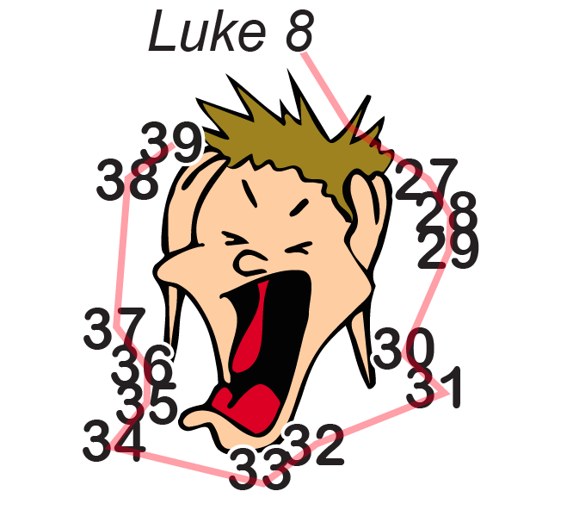
Moving to a picture…

Slide 5
Well, that’s interesting, but
… what is it?!

Slide 6
StudyMap… a visual way to learn and recall a story

Slide 7
Spatial and Positional referencing aids in learning and recalling the details of the story, verse by verse

Slide 8
Notice that the numbered verses are grouped into ‘chunks’ – which aids in recall

Slide 9
Now the 14 verses are grouped into 5 chunks which are much easier to recall… once the chunks are learned, the next layer of recall involves adding secondary support images or icons…

Slide 10
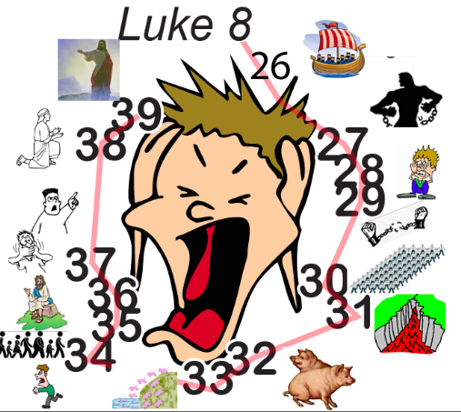
Adding visual and mental cues to the image

Slide 11
The smaller images or icons take their meaning from the text. The visual stimuli of the icons cements the meaning of the text into my mind quite nicely.

Slide 12
I review these sporadically, using the time just before going to sleep or right after waking as excellent review times.

Slide 13
So this:
Jesus and his disciples arrived at the country of the Gerasenes, which is over against Galilee. And when he was come forth upon the land, there met him a certain man out of the city, who had demons; and for a long time he had worn no clothes, and abode not in any house, but in the tombs. And when he saw Jesus, he cried out, and fell down before him, and with a loud voice said, What have I to do with thee, Jesus, thou Son of the Most High God? I beseech thee, torment me not. For he was commanding the unclean spirit to come out from the man. For oftentimes it had seized him: and he was kept under guard, and bound with chains and fetters; and breaking the bands asunder, he was driven of the demon into the deserts. And Jesus asked him, What is thy name? And he said, Legion; for many demons were entered into him. And they entreated him that he would not command them to depart into the abyss. Now there was there a herd of many swine feeding on the mountain: and they entreated him that he would give them leave to enter into them. And he gave them leave.
And the demons came out from the man, and entered into the swine: and the herd rushed down the steep into the lake, and were drowned. And when they that fed them saw what had come to pass, they fled, and told it in the city and in the country. And they went out to see what had come to pass; and they came to Jesus, and found the man, from whom the demons were gone out, sitting, clothed and in his right mind, at the feet of Jesus :and they were afraid. And they that saw it told them how he that was possessed with demons was made whole.
And all the people of the country of the Gerasenes round about asked him to depart from them, for they were gripped with great fear: and he entered into a boat, and returned. But the man from whom the demons were gone out prayed him that he might be with him :but he sent him away, saying, Return to thy house, and declare how great things God hath done for thee. And he went his way, publishing throughout the whole city how great things Jesus had done for him

Slide 14
Becomes this:

Slide 15
Which one do you think I recall more easily?!
The images of course!!

Slide 16
‘Learning How to Learn’ is helping me further the use of these StudyMaps for my goal of embedding 200 such stories into my working and long term memory. Thank you!
~ Ray Neu
Global Oral Learning Coordinator
Church of the Nazarene

